Slide 1
Measuring the Impact of Screening Guidelines (and other interventions) on STDs in MSM
Kevin Weiss, Jeb Jones, Emeli Anderson, Thomas Gift, Harrell Chesson, Kyle Bernstein, Kimberly Workowski, Karen Hoover, Ashleigh Tuite, Eli Rosenberg, Samuel Jenness
STD Prevention Conference
Measuring New Interventions and Their Impact on STD Morbidity
August 30, 2018

Slide 2
Disclosures
I have no disclosures to make

Slide 3

NCHHSTP Epidemiologic and Economic Modeling Agreement
A 5-year cooperative agreement funded by CDC/NCHHSTP to further modeling efforts in five areas:
The goal is to create and adapt models that can be used to support public health decision-making and effectiveness at national, state and local levels.
HIV Tuberculosis Sexually Transmitted Diseases | Viral Hepatitis School/Adolescent Health
This works was supported by the CDC/NCHHSTP Epidemiological and Economic Modeling Agreement (5U38PS004646). The findings and conclusions are solely the responsibility of the authors and do not necessarily represent the official views of the Centers for Disease Control and Prevention or the Department of Health and Human Services.
Notes:
This work is supported by an ongoing cooperative agreement with CDC, with foci in five different areas, with a goal of producing models that can aid in decision-making and evaluate effectiveness at national and subnational levels

Slide 4
Screening Recommendations: 2015 STD Treatment Guidelines
Screening Recommendations from the 2015 CDC Sexually Transmitted Disease Treatment Guidelines
 | Chlamydia | Gonorrhea | Syphilis
Men who have sex with men (MSM) | At least annually for sexually active MSM at sites of contact (urethra, rectum) regardless of condom use Every 3 to 6 months if at increased risk | At least annually for sexually active MSM at sites of contact (urethra, rectum, pharynx) regardless of condom use Every 3 to 6 months if at increased risk | At least annually for sexually active MSM Every 3 to 6 months if at increased risk
Processes
Symptoms-based testing vs. asymptomatic screening
Rate-based data (compare with available data)
Site-specific testing and infection
Risk categorization (number of partners, prior STI, CAI, etc…)
Centers for Disease Control and Prevention. Sexually Transmitted Diseases Treatment Guidelines, 2015.
USPSTF, Bibbons-Domingo K, Grossman DC, Curry SJ, Davidson KW, Epling JW Jr, Garcia FA, Gillman MW, Harper DM, Kemper AR, Krist AH, Kurth AE, Landefeld CS, Mangione CM, Phillips WR, Phipps MG, Pignone MP. Screening for syphilis infection in nonpregnant adults and adolescents: US Preventive Services Task Force Recommendation Statement. JAMA 2016;315(21):2321-2327.²
Notes:
Guidelines inform clinical practice
Interested in evaluating the impact of getting MSM to test for STIs as recommended?
Are different testing intervals or targeting strategies more effective at identifying and treating infection?
Have to represent certain processes
Screening vs. testing
Rate data (compare to available period prevalence data)
Site-specific infection and testing
Risk categorization

Slide 5
HIV and STI Transmission in Dynamic Sexual Networks
Temporal exponential random graph models (ERGMs) define partnership formation and dissolution (network model)
Behavioral data from local and national cohorts
Partnership model terms include:
Partner type, race, age, sexual role
HIV epidemiology
Clinical epidemiology and natural history
Treatment initiation and adherence
Transmission dynamics
STI epidemiology
Notes:
Sexual network types include: main, casual, and one-off partnerships
Partnerships depend on model terms
Natural history includes: disease stages, viral load, disease-related mortality
Transmission and treatment
Demographic process
Network models of STIs are a newer endeavor, have seldomly been produced

Slide 6

Screening and Testing Processes
Tested and Treated (Symptoms-based)
Symptoms
Screened and Treated (Asymptomatic)
Not Tested and Treated
Not Screened and Not Treated
Person with newly acquired STI infection
Screened and Treated (Asymptomatic)
No symptoms
Not Screened and Not Treated
Sensitivity Analyses: Interval and coverage of screening
Coverage = $\frac{Number on a testing schedule}{Number eligible to be on a testing schedule}=\frac{Number assigned to test annually}{Number sexually active in the last year}$
Notes:
Here is a flowchart for how testing and screening processes are implemented in this model
Green are positive outcomes (testing, screening, treatment)
Imagine a person with newly acquired STI infection
Model parameters govern the likelihood of symptoms (by anatomical site and by STI)
Likelihood of symptoms-based testing, all others can also be screened

Slide 7
Screening Indications are Dynamic
Sexually Active MSM - Annual Screening
Higher-Risk MSM - Semiannual Screening
Month 0: Entrance
Month 1: Active with Partner A
Month 2: Active with Partner B
Month 3: Clinical Evaluation
>1 partner in prior 6 months? Yes
≥1 partner in prior 12 months? Yes
Test again in 6 months
Month 9: Clinical Evaluation
>1 partner in prior 6 months? No
≥1 partner in prior 12 months? Yes
Test again in 12 months
Risk Categorization:
Lower-Risk/Sexually Active (SA):
At least one partner in prior 12 months
Higher-Risk (HR):
More than one partner in prior 6 months
Notes:
Higher- and lower-risk categorizations
There is an overlap between those considered “higher-risk” and the “lower-risk” groups
Sample person enters the population, is sexually active, and then clinically evaluated

Slide 8
Baseline Model Targets
 | Gonorrhea incidence | Chlamydia incidence | HIV prevalence
Target | 3.5 case/100 person-years | 5.6 cases/100 person-years | 15 cases/100 persons (15%)
Source | Stenger et al. Sex Trans Dis 2017 (SSuN Data – Baltimore, Philadelphia, NYC, SF, California, Washington) | Kelley et al. AIDS Hum Retroviruses 2015 (Atlanta) | Rosenberg et al. JMIR Public Health Surveill 2016 (National estimate)
 | MSM living with HIV |  | HIV-negative MSM
 | Tested for gonorrhea in the last year | Tested for chlamydia in the last year | Tested for gonorrhea in the last year | Tested for chlamydia in the last year
Target | 64.1% | 62.8% | 45.8% | 45.8%
Source | NHBS | NHBS | NHBS | NHBS
Serostatus-specific screening rates
Note: No “higher-risk” testing assumed
Notes:
Model targets
SSuN data
Atlanta cohort data
Estimates

Slide 9
Results

Slide 10
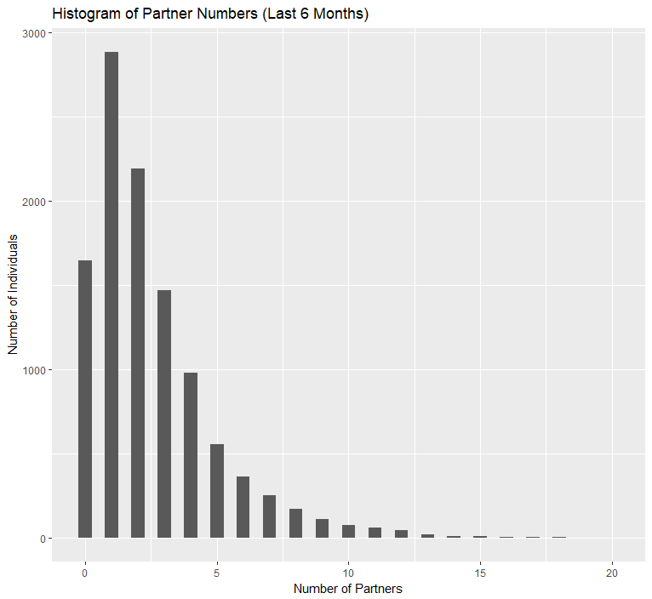
Distribution of Sexual Partnerships
26.6%
15.2%: No recent partners
46.8%: 1-2 recent partners
27.6%: 3-5 recent partners
20.2%
92.3% (92.1 – 92.5) are sexually active in prior 12 months
“Lower-risk” denominator
15.2%
13.5%
59.1% (58.5 – 59.6) had > 1 partner in prior 6 months
“Higher-risk” denominator
Number of People
9.0%
9.0%
1.4%
5.1%
Number of Partners
Notes:
Proportions reflect average of final follow-up year
Histogram shows a snapshot at a final time step
These proportions represent denominators for the testing risk groups

Slide 11
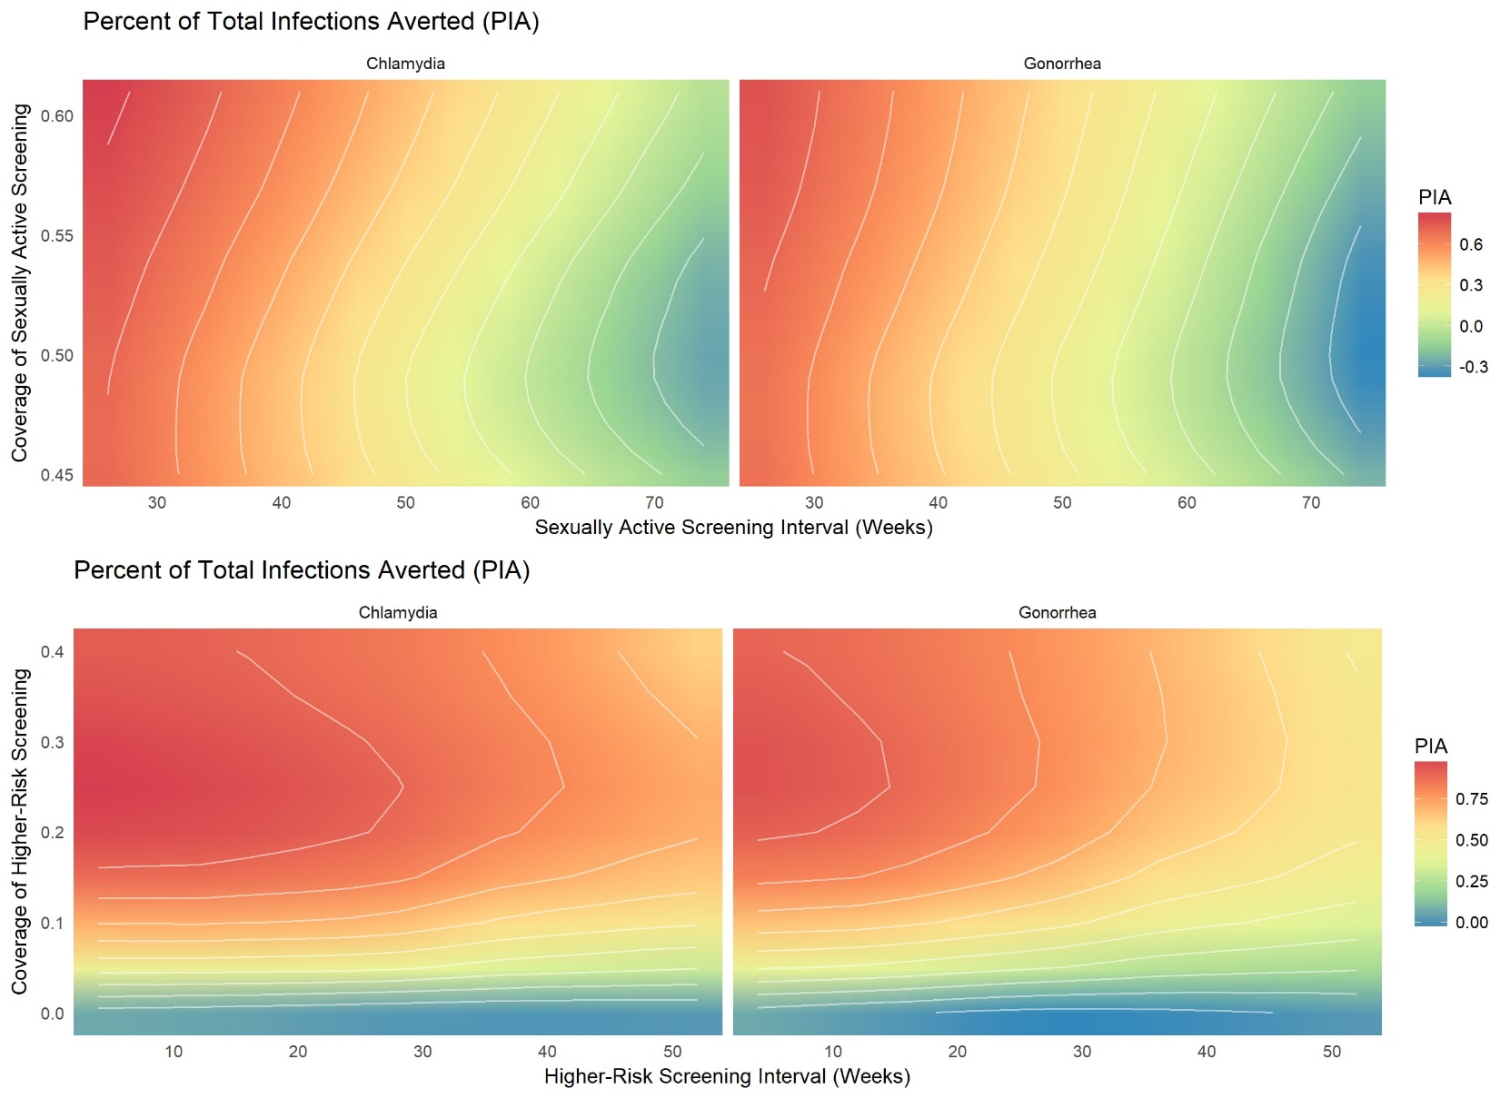
Regular, Frequent Screening Averts Infections
Percent of total infections averted (PIA)
6 months
NG
6 months
CT
12 months
12 months
PIA
Lower-Risk Group Screening Coverage
Longer interval → Decreased PIA
Length of Screening Interval
Notes:
Here is a contour plot, showing a sensitivity analysis of two factors (many different scenarios)
the coverage of sexually active (top left and top right) and higher-risk (bottom left and bottom right) screening
sexually active (top left and top right) and higher-risk (bottom left and bottom right) screening intervals
Darker red represents a more effective intervention (higher PIA), green and blue represent the least effective intervention (lowest PIA)
A longer interval between screening visits resulted in a less effective intervention
A potential recommendation to test semiannually, rather than annually, would further reduce infections

Slide 12
Greater Coverage means More Tests
 | NG
Model Scenario | PIA (IQR) | NNS (IQR)
Base Model (Baseline SA Coverage) | --- | ---
SA Screening Coverage (0% HR Coverage)
10% increase | 0.1 (-0.5, 0.4) | 1.3 (-1.4, 3.0)
20% increase | 0.2 (-0.5, 0.5) | 2.0 (-3.6, 4.7)
30% increase | 0.2 (-0.3, 0.5) | 2.7 (-8.1, 6.7)
40% increase | 0.3 (-0.1, 0.6) | 4.8 (-6.8, 10.7)
HR Screening Coverage (Baseline SA Coverage)
10% | 0.6 (0.3, 0.8) | 13.9 (8.1, 22.9)
20% | 0.7 (0.4, 0.8) | 21.9 (14.0, 43.9)
30% | 0.8 (0.6, 0.9) | 26.1 (16.9, 45.2)
40% | 0.8 (0.7, 0.9) | 27.6 (20.1, 48.3)
Note: A 10% relative increase in sexually active screening is not an equivalent increase in tests to increasing to 10% higher-risk screening coverage
Increasing screening coverage among the higher-risk group averts a greater number of infections, but at a cost to efficiency (financial implications)
Notes:
This table shows the percent of infections averted and the NNS (number needed to screen) under different scenarios of increased coverage
HR means higher-risk, SA means sexually active, or the lower-risk group
Higher-risk means >1 partner here
NNS = Number of screening tests needed to prevent one new infection
Magnitude of tests differs greatly in these counterfactual scenarios
Cost implications
Efficiency varies over time
Data not shown: more testing leads to fewer treated cumulatively

Slide 13
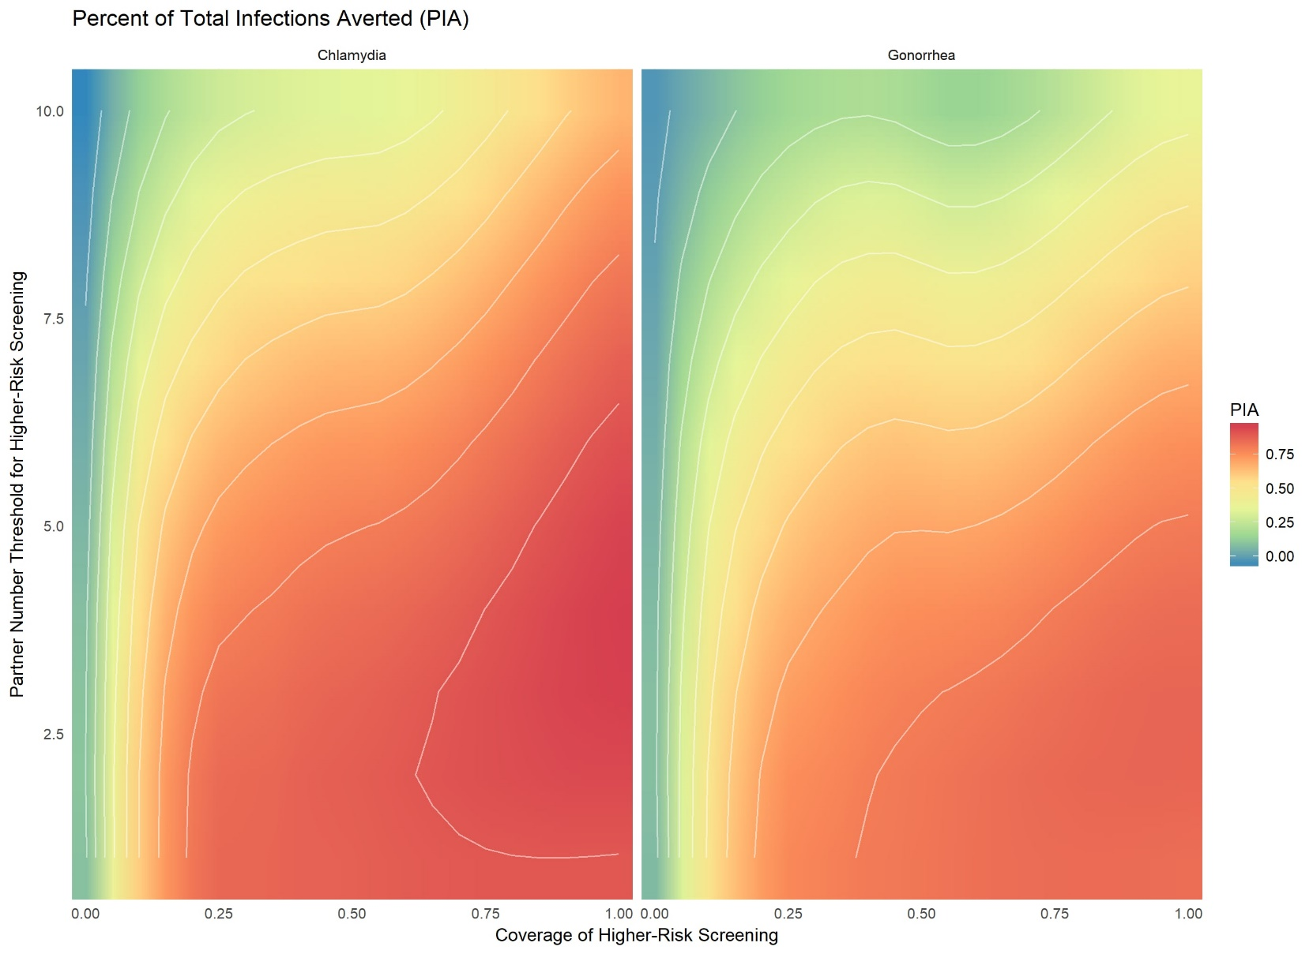
Percent of Infections Averted by Higher-Risk Threshold and Coverage
Percent of total infections averted (PIA)
NG
15%
CT
More than 8 partners in prior 6 months
60%
Higher threshold→ smaller group →
reduced PIA
PIA
Higher-Risk Partner Threshold
Increased coverage → larger group → Increased PIA
More than 2 partners in prior 6 months
Higher-Risk Screening Coverage
Size of the higher-risk group drives the population-level impact
Notes:
Here is a contour plot, showing a sensitivity analysis of two factors (many different scenarios)
the coverage of higher-risk screening
the number of partners in the previous 6 months required to be considered “higher-risk”)
Darker red represents a more effective intervention (higher PIA), green and blue represent the least effective intervention (lowest PIA)
Increasing from a threshold of 2 partners to 8 partners reduces the size of the “higher-risk” group, limiting the number of people screening more frequently
This reduces the population-level impact
Increasing coverage from 15 to 60% increases the number of people adhering to an annual screening trajectory
Increases population-level impact

Slide 14
Findings
Adherence to screening recommendations can avert infections
With follow-up, fewer cumulative infections and treatments
Targeted screening can be a useful strategy
Size of “higher-risk” group is a key driver
Important to also address STIs in a lower-risk population
Limitations
Model assumptions
Network structure, epidemiology, behavioral data
Ongoing work to include syphilis
Notes:
This model demonstrates the effect of increased screening and provides possible implementation scenarios
Adherence to the screening recommendations can avert infections
Further changes to recommended screening interval could reduce infections
Increasing numbers of persons adhering to recommendations would also reduce infections
Model assumptions include:
Network structure
HIV and STI prevalence
Act and partnership data (anal intercourse only)

Slide 15
Further STD Model Applications
Population attributable fraction (PAF) of STIs on HIV
Jeb Jones Late-Breaker (4F3)
Different risk categorizations for STI screening
Network- and partner-based targeting strategies
Exploring antimicrobial resistance (AMR)
Cost-effectiveness and resource allocation
Number needed to screen
Optimized recommendations
Notes:
Other indications might include: Recent diagnosed STI, recent CAI

Slide 16
Acknowledgements
CAMP Public Health Advisory Group
Emory
Samuel Jenness
Jeb Jones
Monica Trigg
Taylor Wimbly
Emeli Anderson
Kevin Maloney
Albany
Eli Rosenberg
CDC
DSTDP
DHAP
OD
Kyle Bernstein
Tom Gift
Harrell Chesson
Kim Workowski
Harvard/UToronto
Ashleigh Tuite

Slide 17
Expedited Partner Therapy
Partner notification strategies and network-based strategies
Treat partners more quickly, arrest spread and reinfection
Caveat: Concerns about EPT for MSM
Missed opportunities for screening for HIV, AMR
Modeling
Scenarios: Partnership window, coverage, Provision
Outcomes: Mean times infected, PIA, proportion without STI
Provision of medication to index patients
Provision of medication to non-index partners
Uptake of medication by non-index partners
Treatment success
Notes:
Here are some sample statistics that can be collected
Percent of infections averted
Mean times infected (goal is to reduce reinfection)
Proportion of partners provided with medication who do not have prevalent HIV or STI infection
Other counterfactual scenarios beyond the EPT continuum
Targeting particular partnership types

